Slide 1


Spam mail detection
Dia Kaul Minautee

Slide 2

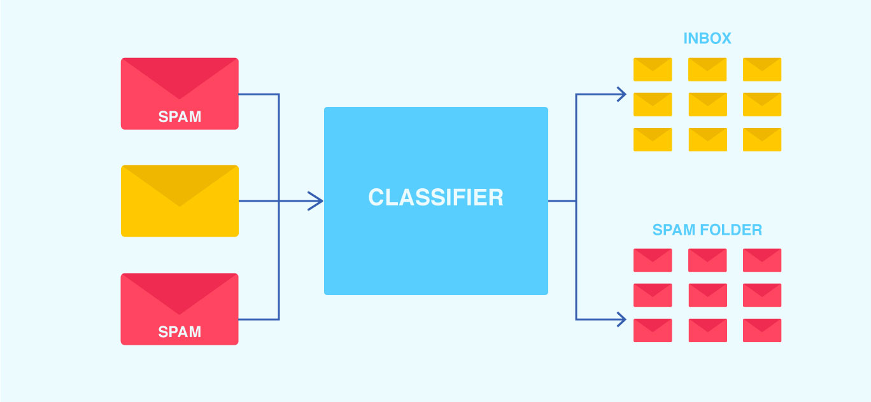
PROBLEM STATEMENT
Build a spam email detector using AI/ML. (Do appropriate data pre-processing and post processing mechanisms as required.)

Slide 3

approach for overcoming it
The following steps were implemented to solve the given problem: 1. We took a dataset of numerous emails
Import libraries
Import the dataset.(with markings as ‘ham’ or ‘spam’)
We drop the duplicate values
We check for null values.
Define process to remove punctuations
Remove the stop-words.
Converting the filtered text to token count matrix.( Basically mentions the number of words also repetitions)
Split dataset into training set(80%) and test set(20%).
Standardize the features.
Train and fit the model.
Test model.

Slide 4
naïve BAYES Classifier
Naive Bayes Classifier Algorithm is a family of probabilistic algorithms.
Multinomial Naive Bayes algorithm is a probabilistic learning method. The algorithm is based on the Bayes theorem and predicts the tag of a text such as a piece of email or newspaper article. It calculates the probability of each tag for a given sample and then gives the tag with the highest probability as output.
It uses bayes theorem which calculates the probability of an event occurring based on the prior knowledge of conditions related to an event. It is based on the following formula:
P(A|B) = P(A) * P(B|A)/P(B)
Where we are calculating the probability of class A when predictor B is already provided.
P(B) = prior probability of B
P(A) = prior probability of class A
P(B|A) = occurrence of predictor B given class A probability

Slide 5

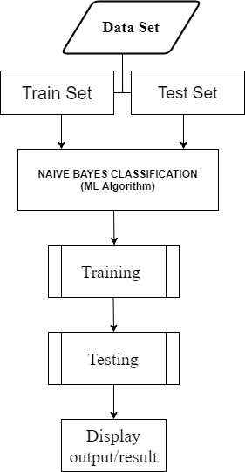
Diagram of the Data Flow

Slide 6

Stack of Technology
PYTHON
GOOGLE COLAB
GITHUB
KAGGLE

Slide 7
Advantages and disadvantages:
Advantages
disadvantages
We have used the naïve-bayes theorem best suited for this problem.
The process contains “bad of words” model, so it builds safe connection between user’s mail transfer agent(MTA) and mail user agent(MUA)
Accuracy of the program is more than average i.e., 97.3%
The accuracy of other spam mail detection mechanisms are more than this usually!
Time Consuming
The accuracy can be increased by using multiple algorithms and larger data set.

Slide 8
Before and after bridge
In our day to day lives we get numerous mails, but not all of them are of our use. Mails called as “spam mails” are very frequent now-a-days. For example, these include mails conveying any free item or maybe lotteries and many other type of advertisements. With this model we have come across way to categorize “spam mail” and “ham”/useful mails.
Our approach provides ideal solutions for the analysis which is mail containing regular words which are ought to be in a spam mail. This will make it efficient and have less human interaction in differentiating both.

Slide 9
Thank you !!

